Slide 1


Intro to Brown & Brown Employee Benefits
Town of Mendon Board Meeting
April 27, 2026
We Make Your People
Our Business
Private and Confidential
BROWN & BROWN | 1
Notes:
B/Jack- jack as chairman-

Slide 2
Agenda
1
Town of Mendon Medicare Program VS FLMHIT Medicare Program
2
Town of Mendon Active Benefits & Analysis
3
Appendix
4
Disclaimers
BROWN & BROWN | 2
Notes:
M

Slide 3

Town of Mendon Medicare Program & FLMHIT Analysis

Slide 4
FLMHIT Medicare Consortium Members
Bath Electric, Gas & Water
Town of Brighton
City of Geneva
City of Glens Falls
Town of Greece
Town of Irondequoit
Town of Perinton
Town of Pittsford
Town of Rush
Town of Chili
Village of East Rochester
Town of Penfield
Monroe County Water Authority
Town of Farmington
Town of Webster
Rochester Housing Authority
Town of Ogden
Town of Victor
Village of Bath
Village of Fairport
Town of Torrey
Brighton Fire District
The listed communities comprise the FLMHIT Consortium, representing 1,800 retirees
The information and intellectual capital contained in this presentation is private & confidential and specifically for the use of FLMHIT only.
BROWN & BROWN | 4
Notes:
B

Slide 5
Current Medicare Plan
Benefit | Town of Mendon
 | Excellus BCBS
 | Package/Shelf Plan
 | HMO $20/$30 $5/$30/$75
Network | HMO
Fitness Program | FitOn Health
Primary Care Physician | $20-InNetwork/20%-OONet
Specialist Physician | $30-InNetwork/20%-OONet
Chiropractor | $20-InNetwork/20%-OONet
Ambulance | $65
Emergency Room | $65
Urgent Care Center | $30
Vision Exam | $30-InNetwork/20%-OONet
Eyewear Allowance | $100 Allowance per year
Hearing Exam | $0, must use a TruHearing Provider
Hearing Aid Allowance | $499 Copay for Advanced Hearing Aids or $799 Copay for Premium Hearing Aids. Limit 2 per calendar year. Must use TruHearing Provider.
In-Patient Hospital | $400-InNetwork/ 20%Coinsurance-OONet
Out-Patient Surgery - Surgery Center | $50 /20%-OONet
Durable Medical Equipment | 20%
Rx (30 day) | $5/$30/$75
Rx (90 day) | $12.50/$75/$187.50
Rx Out-of-Pocket Maximum | $2,000
Deductible | None
Co-Insurance | None-In Network/20%-OO Network
Medical Out-of-Pocket Max: Combined In&Out of Network (excludes Rx, eyewear & hearing aids) | $3,400-InNetwork / $5,000-OONetwork Max
Current Estimated Medical Cost Summary
Plan | Tier | Monthly Premium | # Enrolled | Total Annual Plan Premiums
Excellus BCBS | EE | $533.90 | 6 | $38,441
Grand Total |  |  | 6 | $38,441
BROWN & BROWN | 5
Notes:
M

Slide 6
2026 Medicare Plan vs. FLMHIT
Benefit | Town of Mendon |  | FLMHIT | FLMHIT
 | Excellus BCBS |  | Excellus BCBS | Excellus BCBS
 | Package/Shelf Plan | * | Custom Owned Plan | Custom Owned Plan
 | HMO $20/$30 $5/$30/$75 | 6 | Plan 3 | Plan 8
Network | HMO |  | Passive PPO | Passive PPO
Fitness Program | FitOn Health |  | FitOn Health | FitOn Health
Primary Care Physician | $20-InNetwork/20%-OONet |  | $15 | $15
Specialist Physician | $30-InNetwork/20%-OONet |  | $15 | $15
Chiropractor | $20-InNetwork/20%-OONet |  | $15 | $15
Ambulance | $65 |  | $15 | $15
Emergency Room | $65 |  | $50 | $50
Urgent Care Center | $30 |  | $15 | $15
Vision Exam | $30-InNetwork/20%-OONet |  | $0 | $0
Eyewear Allowance | $100 Allowance per year |  | $100 Allowance per year | $100 Allowance per year
Hearing Exam | $0, must use a TruHearing Provider |  | $0, must use a TruHearing Provider | $0, must use a TruHearing Provider
Hearing Aid Allowance | $499 Copay for Advanced Hearing Aids or $799 Copay for Premium Hearing Aids. Limit 2 per calendar year. Must use TruHearing Provider. |  | $499 Copay for Advanced Hearing Aids or $799 Copay for Premium Hearing Aids. Limit 2 per calendar year. Must use TruHearing Provider. | $499 Copay for Advanced Hearing Aids or $799 Copay for Premium Hearing Aids. Limit 2 per calendar year. Must use TruHearing Provider.
In-Patient Hospital | $400-InNetwork/ 20%Coinsurance-OONet |  | $100 | $250
Out-Patient Surgery - Surgery Center | $50 /20%-OONet |  | $50 | $50
Durable Medical Equipment | 20% |  | 20% | 20%
Rx (30 day) | $5/$30/$75 |  | $5/$25/$50 | $5/$25/$50
Rx (90 day) | $12.50/$75/$187.50 |  | $5/$25/$50 | $10/$50/$100
Rx Out-of-Pocket Maximum | $2,000 |  | $2,000 | $2,000
Deductible | None |  | None | None
Co-Insurance | None-InNetwork/20%-OONetwork |  | None | None
Medical Out-of-Pocket Max: Combined In&Out of Network (excludes Rx, eyewear & hearing aids) | $3,400-InNetwork / $5,000-OONetwork Max Coverage |  | $2,100 total combined In & Out of Network | $2,100 total combined In & Out of Network
Monthly Rate | 2026 Rate |  | FLMHIT - 2026 Rates for Custom Owned Benefit Plans
Retiree | $533.90 | 6 | $387.17 | $361.51
Monthly Change ($) |  |  | -$146.73 | -$172.39
Monthly Change (%) |  |  | -27% | -32%
Annual Change ($) |  |  | -$1,760 | -$2,064
Estimated Total Annual Premium: | $38,441 |  | $27,876 | $26,028
Estimated Total Annual Premium Change vs. Current ($) |  |  | -$10,565 | -$12,413
Estimated Total Annual Premium Change vs. Current (%) |  |  | -27% | -32%
This plan design contains only a general description of the coverage and does not constitute a policy contract. For complete information including exclusions, Limitations and conditions, refer to the policy document. Neither the carrier nor Brown & Brown will be held responsible for typographical or clerical errors.
BROWN & BROWN | 6
Notes:
B

Slide 7

Prospective FLMHIT Consortium Member Next Steps
FLMHIT Medicare Consortium participation decision
Memorandum of Understanding (one-time entry fee of 5% of savings with a $1,000 minimum)
Intermunicipal Cooperation Agreement
Implementation Effective Date Decision (30-day process)
i.e. June 1st, 2026
Communicate New Plan Benefits to Post-65 Employee
New ID Cards
New Excellus Medicare Plan Group ID Number
The information and intellectual capital contained in this presentation is private & confidential and specifically for the use of FLMHIT only.
BROWN & BROWN | 7
Notes:
B

Slide 8
Town of Mendon Active Benefits

Slide 9
Current Medical Benefit Plans
Benefits | Excellus Health Plan | Excellus Health Plan | Excellus Health Plan | Excellus Health Plan
 | 2026 Platinum 2 | 2026 Gold 5 | ALTERNATE - 2026 Gold 17 | 2026 Silver 19
PCP | $15 copay | $40 copay | $40 copay | $25 copay, subject to the deductible
Specialist | $40 copay | $70 copay | $70 copay | $50 copay, subject to the deductible
Inpatient Hospital | $500 copay | $1,500 copay | Covered at 80%, subject to the deductible | $500 copay, subject to the deductible
Outpatient Surgery | $400 copay | $650 copay | Covered at 80%, subject to the deductible | $350 copay, subject to the deductible
Prescription Drug | $10/$35/$70 | $15/40%/50% | $10/$45/$90 | $5/$45/$90, subject to the plan deductible. Preventive RX
Telemedicine | Covered In Full Teledermatology $40 copay | Covered In Full Teledermatology $70 copay | Covered In Full Teledermatology $70 copay | Covered In Full, subject to deductible Teledermatology $50 copay
In-Network Deductible | None | None | $1,100/$2,200 | $3,600/$7,200
In-Network Coinsurance | None | None | 20% | None
In-Network Out-of-Pocket Maximum | $5,000/$10,000 | $9,200/$18,400 | $8,250/$16,500 | $8,000/$16,000
In-Network Individual enrolled in Family Plan Out-of-Pocket Maximum Cap | $5,000 | $9,200 | $8,250 | $8,500
Out-of-Network | Covered at 80%, subject to the deductible | Covered at 80%, subject to the deductible | Covered at 60%, subject to the deductible | Covered at 60%, subject to the deductible
ER | $300 copay | $650 copay | $300 copay | $350 copay, subject to the deductible
Urgent Care | $40 copay | $70 copay | $70 copay | $50 copay, subject to the deductible
BROWN & BROWN | 9
Notes:
M

Slide 10
FLMHIT Consortium Members
Bath Electric, Gas & Water
Town of Brighton
Fairport Electric
Town of Greece
Town of Irondequoit
Town of Perinton
Town of Pittsford
Town of Chili
Village of East Rochester
Town of Penfield
Monroe County Water Authority
Town of Webster
Rochester Housing Authority
Town of Ogden
Town of Victor
Village of Bath
Village of Fairport
Town of Henrietta
City of Canandaigua
BROWN & BROWN | 10
The information and intellectual capital contained in this presentation is private & confidential and specifically for the use of FLMHIT only.
Notes:
B

Slide 11
Benchmarks – Municipality Industry Plan Offerings
Silver
Gold
Platinum
Silver
Gold
Platinum
FLMHIT Benchmarks 2026
BROWN & BROWN | 11
Notes:
M

Slide 12
Employer Contribution Benchmarks
FLMHIT Core Plan (Platinum)
FLMHIT $3,000/$6,000 (Silver)
Town of Mendon : 74%
FLMHIT Hybrid Plan (Gold)
Town of Mendon : 80%
Town of Mendon : 82%
FLMHIT Benchmarks 2026
BROWN & BROWN | 12
Notes:
M

Slide 13
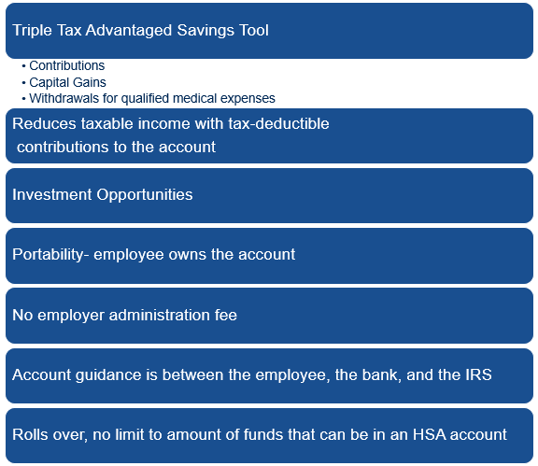
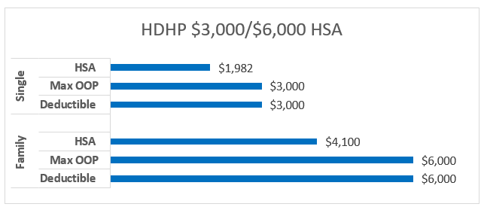
Employer Contribution Benchmarks- HSA Benefits
FLMHIT Benchmarks 2026
BROWN & BROWN | 13
Notes:
M

Slide 14
Appendix

Slide 15
Current Medical Plan Financials
Current Estimated Medical Cost Summary
Plan | Tier | Monthly Premium | ER Cost | EE Cost | ER % | EE % | # Enrolled | ER Annual Total Cost | EE Annual Total Cost | Total Annual Plan Premiums | % enrolled
Platinum 2 | EE+1 | $2,842.92 | $2,092.50 | $750.42 | 74% | 26% | 1 | $25,110 | $9,005 | $34,115 | 8%
Plan 1 Total |  |  |  |  |  |  | 1 | $25,110 | $9,005 | $34,115
Gold 5 (25%) | EE | $1,216.57 | $912.43 | $304.14 | 75% | 25% | 1 | $10,949 | $3,650 | $14,599 | 84%
Gold 5 (20%) | EE | $1,216.57 | $973.26 | $243.31 | 80% | 20% | 3 | $35,037 | $8,759 | $43,797
 | EE+Children | $2,068.18 | $1,654.54 | $413.64 | 80% | 20% | 1 | $19,854 | $4,964 | $24,818
Gold 5 (18%) | Family | $3,467.23 | $2,843.13 | $624.10 | 82% | 18% | 1 | $34,118 | $7,489 | $41,607
Gold 5 (14%) | EE | $1,216.57 | $1,046.25 | $170.32 | 86% | 14% | 2 | $25,110 | $4,088 | $29,198
 | EE +1 | $2,433.14 | $2,092.50 | $340.64 | 86% | 14% | 1 | $25,110 | $4,088 | $29,198
Gold 5 (10%) | EE | $1,216.57 | $1,094.91 | $121.66 | 90% | 10% | 2 | $26,278 | $2,920 | $29,198
Plan 2 Total |  |  |  |  |  |  | 11 | $176,456 | $35,957 | $212,413
Silver 19 | EE | $964.11 | $771.29 | $192.82 | 80% | 20% | 1 | $9,255 | $2,314 | $11,569 | 8%
Plan 3 Total |  |  |  |  |  |  | 1 | $9,255 | $2,314 | $11,569
Grand Total |  |  |  |  |  |  | 13 | $210,822 | $47,276 | $258,098 | 100%
Enrollment & Contribution strategy provided by Town of Mendon March 2026
BROWN & BROWN | 15
Notes:
M

Slide 16
Alternate Benchmarked Trio- Financials
Alternate Trio Estimated Financials
Plan | Tier | Monthly Premium | ER Cost | EE Cost | ER % | EE % | # Enrolled | ER Annual Total Cost | EE Annual Total Cost | Total Annual Plan Premiums
Platinum 2 | EE+1 | $2,842.92 | $2,092.50 | $750.42 | 74% | 26% | 1 | $25,110 | $9,005 | $34,115
Plan 1 Total |  |  |  |  |  |  | 1 | $25,110 | $9,005 | $34,115
Gold 5 (25%) | EE | $1,216.57 | $973.26 | $304.14 | 80% | 20% | 1 | $11,679 | $3,650 | $15,329
Gold 5 (20%) | EE | $1,216.57 | $973.26 | $243.31 | 80% | 20% | 3 | $35,037 | $8,759 | $43,797
 | EE+Children | $2,068.18 | $1,447.73 | $620.45 | 70% | 30% | 1 | $17,373 | $7,445 | $24,818
Gold 5 (18%) | Family | $3,467.23 | $2,427.06 | $1,040.17 | 70% | 30% | 1 | $29,125 | $12,482 | $41,607
Gold 5 (14%) | EE | $1,216.57 | $973.26 | $243.31 | 80% | 20% | 1 | $11,679 | $2,920 | $14,599
 | EE +1 | $2,433.14 | $1,703.20 | $729.94 | 70% | 30% | 0 | $0 | $0 | $0
Gold 5 (10%) | EE | $1,216.57 | $973.26 | $243.31 | 80% | 20% | 1 | $11,679 | $2,920 | $14,599
Plan 2 Total |  |  |  |  |  |  | 8 | $116,572 | $38,176 | $154,748
Silver 19 | EE | $964.11 | $819.49 | $144.62 | 85% | 15% | 3 | $29,502 | $5,206 | $34,708
 | EE+1 | $1,928.22 | $1,638.99 | $289.23 | 85% | 15% | 1 | $19,668 | $3,471 | $23,139
 | EE+Children | $1,638.99 | $1,393.14 | $245.85 | 85% | 15% | 0 | $0 | $0 | $0
 | EE+Family | $2,747.72 | $2,335.56 | $412.16 | 85% | 15% | 0 | $0 | $0 | $0
Plan 3 Total |  |  |  |  |  |  | 4 | $49,170 | $8,677 | $57,847
Grand Total |  |  |  |  |  |  | 13 | $190,852 | $55,858 | $246,710
HSA Contribution: $2,000 Single $4,000 Family
HSA Pledge: $10,000
*Scenario Assumes 30% by-down to lower cost plan with HSA Contribution
BROWN & BROWN | 16
Notes:
M

Slide 17
FLMHIT Medicare Consortium Structure
Fully Insured “Carrier at Risk”
Joint & Several Liability – Each member stands on their own for premium payments (NO Joint Liability)
No need to prefund reserves or account for Claims Run-out/terminal liability
Each member controls their own eligibility
Each member controls their own contributions
Each member controls the product offering to their respective employees/retirees
Each member controls their own billing directly with the insurance carrier
Executive Committee consists of SEVEN members (chair, vice chair, and five at-large members)
The information and intellectual capital contained in this presentation is private & confidential and specifically for the use of FLMHIT only.
BROWN & BROWN | 17
Notes:
Brian

Slide 18
Advantages of Consortium Purchasing
Plan Control & Flexibility
Create, own, and control a custom benefit plan
Multiple design options to provide choice
Financial Strength
Improved cost containment
Credible risk pool allows data to be shared
Leverages combined group purchasing power
Shared Expertise
Shared resources and intellectual capital
Key Account status with partners
Administrative Ease
Simplified administration, education, and communication
Dedicated FLMHIT customer service unit
Member Wellbeing
Integrated wellness initiatives
The information and intellectual capital contained in this presentation is private & confidential and specifically for the use of FLMHIT only.
BROWN & BROWN | 18

Slide 19
FLMHIT Custom Owned Medicare Plan Menu
Benefit | FLMHIT | FLMHIT | FLMHIT | FLMHIT | FLMHIT | FLMHIT
 | Excellus BCBS | Excellus BCBS | Excellus BCBS | Excellus BCBS | Excellus BCBS | Excellus BCBS
 | Consortium Rated | Consortium Rated | Consortium Rated | Consortium Rated | Consortium Rated | Consortium Rated
 | Custom Owned Plan | Custom Owned Plan | Custom Owned Plan | Custom Owned Plan | Custom Owned Plan | Custom Owned Plan
 | Plan 1 | Plan 2 | Plan 3 | Plan 4 | Plan 5 | Plan 6
Network | Passive PPO | Passive PPO | Passive PPO | Passive PPO | Passive PPO | Passive PPO
Fitness Program | Silver & Fit | Silver & Fit | Silver & Fit | Silver & Fit | Silver & Fit | Silver & Fit
Primary Care Physician | $0 | $10 | $15 | $15 | $20 | $0
Specialist Physician | $0 | $10 | $15 | $15 | $20 | $0
Chiropractor | $0 | $10 | $15 | $15 | $20 | $0
Ambulance | $0 | $10 | $15 | $15 | $20 | $0
Emergency Room | $0 | $10 | $50 | $50 | $65 | $0
Urgent Care Center | $0 | $10 | $15 | $15 | $20 | $0
Vision Exam | $0 | $0 | $0 | $0 | $0 | $0
Eyewear Allowance | $100 Allowance per year | $100 Allowance per year | $100 Allowance per year | $100 Allowance per year | $100 Allowance per year | $100 Allowance per year
Hearing Exam | $0, must use a TruHearing Provider | $0, must use a TruHearing Provider | $0, must use a TruHearing Provider | $0, must use a TruHearing Provider | $0, must use a TruHearing Provider | $0, must use a TruHearing Provider
Hearing Aid Allowance | $499 Copay for Advanced Hearing Aids or $799 Copay for Premium Hearing Aids. | $499 Copay for Advanced Hearing Aids or $799 Copay for Premium Hearing Aids. | $499 Copay for Advanced Hearing Aids or $799 Copay for Premium Hearing Aids. | $499 Copay for Advanced Hearing Aids or $799 Copay for Premium Hearing Aids | $499 Copay for Advanced Hearing Aids or $799 Copay for Premium Hearing Aids. | $499 Copay for Advanced Hearing Aids or $799 Copay for Premium Hearing Aids.
In-Patient Hospital | $0 | $0 | $100 | $100 | $250 | $0
Out-Patient Surgery Center | $0 | $10 | $50 | $50 | $50 | $0
Durable Medical Equipment | $0 | 20% | 20% | 20% | 20% | $0
Rx (30 day retail) | $5/$5/$5 | $5/$15/$30 | $5/$25/$50 | $5/$30/$75 | $5/$35/$80 | $5/$5/$5
Rx (90 day retail) | $5/$5/$5 | $5/$15/$30 | $5/$25/$50 | $5/$30/$75 | $5/$35/$80 | $15/$15/$15
Rx (90 day mail order) | $5/$5/$5 | $5/$15/$30 | $5/$25/$50 | $5/$30/$75 | $5/$35/$80 | $15/$15/$15
Rx Out-of-Pocket Max (Part-D Drugs) | $2,100 | $2,100 | $2,100 | $2,100 | $2,100 | $2,100
Deductible | None | None | None | None | None | None
Co-Insurance | None | None | None | None | None | None
Medical Out-of-Pocket Max: Combined In&Out of Network (excludes Rx, eyewear & hearing aids) | $0 | $800 | $2,100 | $3,900 | $3,900 | $0
2026 Monthly Rates | $600.18 | $453.92 | $387.17 | $360.11 | $337.79 | $585.85
This plan design contains only a general description of the coverage and does not constitute a policy contract. For complete information including exclusions, Limitations and conditions, refer to the policy document. Neither the carrier nor Brown & Brown will be held responsible for typographical or clerical errors.
Notes:
B

Slide 20
FLMHIT Custom Owned Medicare Plan Menu
Benefit | FLMHIT | FLMHIT | FLMHIT | FLMHIT | FLMHIT
 | Excellus BCBS | Excellus BCBS | Excellus BCBS | Excellus BCBS | Excellus BCBS
 | Consortium Rated | Consortium Rated | Consortium Rated | Consortium Rated | Consortium Rated
 | Custom Owned Plan | Custom Owned Plan | Custom Owned Plan | Custom Owned Plan | Custom Owned Plan
 | Plan 7 | Plan 8 | Plan 9 | Plan 10 | Plan 11
Network | Passive PPO | Passive PPO | Passive PPO | Passive PPO | Passive PPO
Fitness Program | Silver & Fit | Silver & Fit | Silver & Fit | Silver & Fit | Silver & Fit
Primary Care Physician | $10 | $15 | $15 | $20 | $20
Specialist Physician | $10 | $15 | $15 | $20 | $40
Chiropractor | $10 | $15 | $15 | $20 | $20
Ambulance | $10 | $15 | $15 | $20 | $20
Emergency Room | $10 | $50 | $50 | $65 | $65
Urgent Care Center | $10 | $15 | $15 | $20 | $40
Vision Exam | $0 | $0 | $0 | $0 | $40
Eyewear Allowance | $100 Allowance per year | $100 Allowance per year | $100 Allowance per year | $100 per calendar year | $100 per calendar year
Hearing Exam | $0, must use a TruHearing Provider | $0, must use a TruHearing Provider | $0, must use a TruHearing Provider | $0, must use a TruHearing Provider | $0, must use a TruHearing Provider
Hearing Aid Allowance | $499 Copay for Advanced Hearing Aids or $799 Copay for Premium Hearing Aids. | $499 Copay for Advanced Hearing Aids or $799 Copay for Premium Hearing Aids. | $499 Copay for Advanced Hearing Aids or $799 Copay for Premium Hearing Aids | $499 Copay for Advanced Hearing Aids or $799 Copay for Premium Hearing Aids. | $499 Copay for Advanced Hearing Aids or $799 Copay for Premium Hearing Aids.
In-Patient Hospital | $100 | $250 | $250 | $400 | $500
Out-Patient Surgery Center | $10 | $50 | $50 | $50 | $50
Durable Medical Equipment | 20% | 20% | 20% | 20% | 20%
Rx (30 day retail) | $5/$15/$30 | $5/$25/$50 | $7/$30/$80 | $10/$45/$90 | $10/$45/$90
Rx (90 day retail) | $10/$30/$60 | $10/$50/$100 | $14/$60/$160 | $20/$90/$180 | $20/$90/$180
Rx (90 day mail order) | $10/$30/$60 | $10/$50/$100 | $14/$60/$160 | $20/$90/$180 | $20/$90/$180
Rx Out-of-Pocket Max (Part-D Drugs) | $2,100 | $2,100 | $2,100 | $2,100 | $2,100
Deductible | None | None | None | None | None
Co-Insurance | None | None | None | None | None
Medical Out-of-Pocket Max: Combined In&Out of Network (excludes Rx, eyewear & hearing aids) | $800 | $2,100 | $3,900 | $3,900 | $3,900
2026 Monthly Rates | $433.77 | $361.51 | $334.37 | $300.23 | $261.15
This plan design contains only a general description of the coverage and does not constitute a policy contract. For complete information including exclusions, Limitations and conditions, refer to the policy document. Neither the carrier nor Brown & Brown will be held responsible for typographical or clerical errors.
Notes:
B

Slide 21
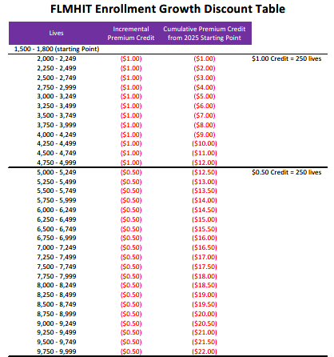

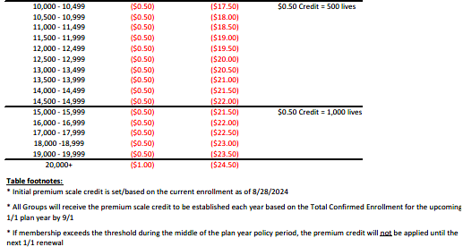
FLMHIT Medicare Consortium Growth Discounts
This plan design contains only a general description of the coverage and does not constitute a policy contract. For complete information including exclusions, Limitations and conditions, refer to the policy document. Neither the carrier nor Brown & Brown will be held responsible for typographical or clerical errors.
BROWN & BROWN | 21
Notes:
B

Slide 22
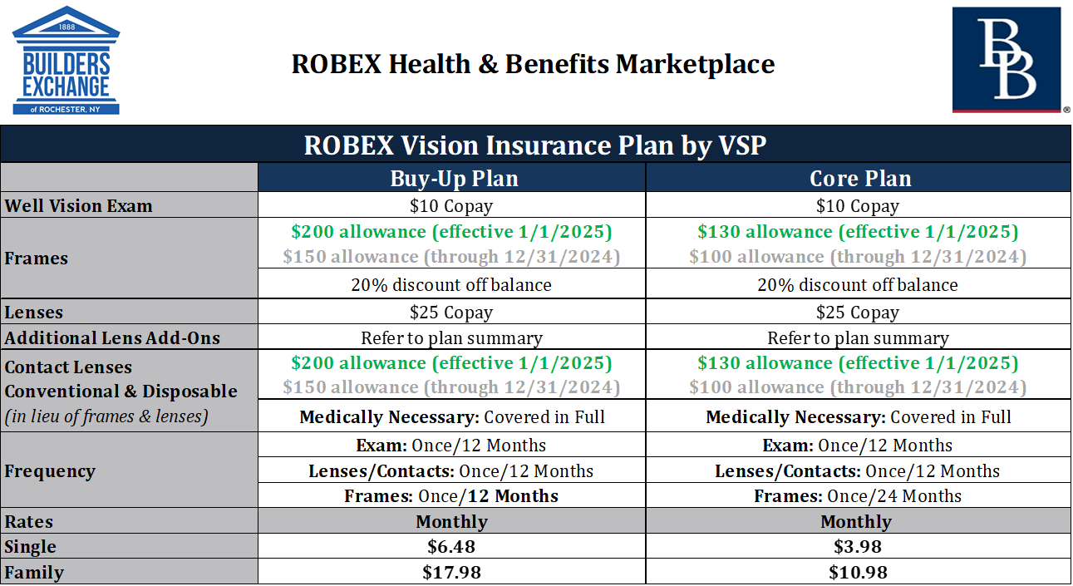
Vision - Value-added Choice through B&B Consortiums
Dual offering allows employees to pick a plan that fits their needs and budget.
No benefit waiting periods for new enrollees.
No net rate increase in 12 years!
4 Year rate guarantees
Over 4,900 covered lives in the program!
Carrier is VSP
Key/National Account Service (like being a large county or small state government)
Municipalities are now eligible to join this successful purchasing program due to “similar/like” employee populations (highway, office, etc.)
Notes:
New Members:
Elite Alliance
Town of Henrietta
Town of Victor*
New Energy Works

Slide 23
Dental - Value-added Choice through B&B Consortiums
3-plan offering allows employees to pick a plan annually that fits their needs & budget.
No benefit waiting periods for new enrollees.
Currently 4,000+ covered lives in the program!
Administered by Lincoln Financial Group
Key/National Account Service (like being a large county or small state government)
Municipalities are now eligible to join this successful purchasing program due to “similar/like” employee populations (highway, office, etc.)
10 Enrolled Minimum
Source: HR Works

Slide 24
Specified Disease Benefit (Highlights) Through Guardian
Fills gaps that are present due to high deductible health plans (HDHPs) and other common medical plans in today’s benefits market
Out of pocket medical costs have continued to increase over the past decade. Most families are living paycheck to paycheck and cannot afford to incur the costs associated with a critical illness diagnosis
Americans borrowed an estimated $88 billion over the last year to pay for health care. One in four Americans have skipped treatment because of the cost, and that nearly half fear bankruptcy in the event of a health emergency. (Gallup and West Health survey results March 2019)
62% of bankruptcies are attributed to major medical expenses. 75% of those people had major medical insurance (American Journal of Medicine 2019)
2 levels of coverage that can be purchased: EE & or EE/Spouse & Children (Children are automatically covered for free regardless of number)
Guarantee Issue at initial offering…no medical questions asked, no blood/urine
Fully portable: individuals can continue coverage after they no longer work for the employer (pay direct)
Pre-existing Condition Exclusion is 6/6 (6-month look back / 6-month benefit waiting period)
$50 annual wellness benefit for employee, spouse and child(ren)
* The above language provided by Guardian Life Insurance Co. of NY
*This plan design contains only a general description of the coverage and does not constitute a policy contract. For complete information including exclusions, Limitations and conditions, refer to the policy document. Neither the carrier nor Brown & Brown will be held responsible for typographical or clerical errors.

Slide 25
Accident Benefit (Highlights) Through Guardian
Pays benefits for covered employees, spouses, and children based on injuries incurred due to an accident and the medical procedures that follow
Most people do not have money set aside in savings to pay for unexpected costs associated with injuries caused by accidents
Fills gaps that are present due to high deductible health plans (HDHPs) and other common medical plans in today’s benefits market
Out of pocket costs have continued to increase over the past decade, and most families are living paycheck to paycheck and cannot afford to incur the costs associated with unexpected injuries due to accidents. Accident insurance fills these gaps
Americans borrowed an estimated $88 billion over the last year to pay for health care. One in four Americans have skipped treatment because of the cost, and that nearly half fear bankruptcy in the event of a health emergency. (Gallup and West Health survey results March 2019)
62% of bankruptcies are attributed to major medical expenses. 75% of those people had major medical insurance (American Journal of Medicine 2019)
Pays based on a schedule of benefits and benefits do not offset with other types of insurance, including major medical. Benefit payments can be spent as the EE wishes
Claims are adjudicated based on Doctor records, medical EOBs, and EE comments
* The above language provided by Guardian Life Insurance Co. of NY
*This plan design contains only a general description of the coverage and does not constitute a policy contract. For complete information including exclusions, Limitations and conditions, refer to the policy document. Neither the carrier nor Brown & Brown will be held responsible for typographical or clerical errors.

Slide 26


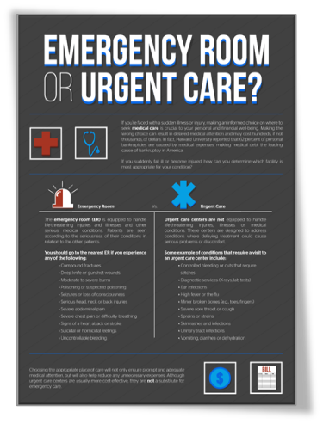

Employee Education

Slide 27



Employment Law “On-Call” Resource
Brown & Brown has created the industry’s first Employment Counsel “On-Call” Risk Management and Labor Counsel Program.
Through our partnership with Foley and Foley P.C., the service provides your company with In-House Employment Counsel to address day-to-day issues.
This Labor Triage program allows our clients to substantially reduce HR-related risk and reduce employment law related cost (claims, litigation and legal fees).
Our employment lawyers decipher the complexities that you address on a daily basis, so that you can focus on other priorities.
You will have access to experienced labor attorneys licensed in all states that are on-call to provide indemnified answers to your Labor related questions and issues through a dedicated 1-800 number.
This service is inclusive in the Brown & Brown service offering as a value-added service and not intended to displace your existing internal and/or external counsel.

Slide 28




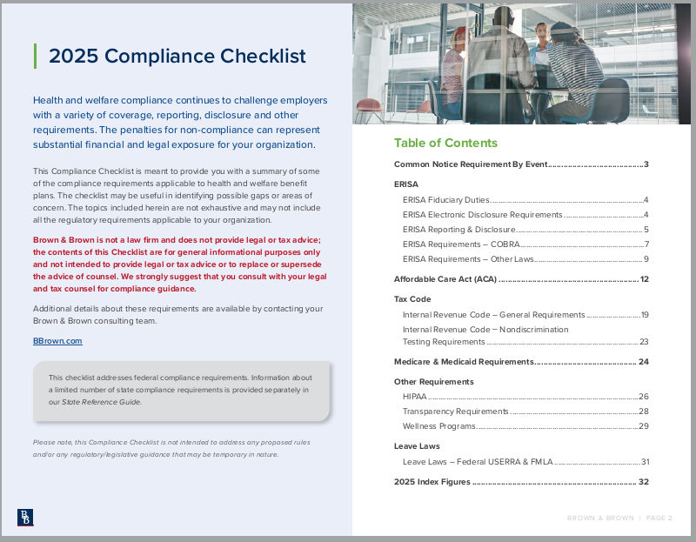
Our Compliance Services
Your Dedicated
Compliance Consultant
Elizabeth Cade
Director of Compliance
Compliance Review
Vendor Resources
Communications
Notice Requirements
ERISA Reporting and Disclosure
ACA Guidance
Tax Code
Medicare & Medicaid Requirements
Health Insurance Portability and Accountability Act (HIPAA)
Transparency Requirements
Wellness Programs
Leave Laws
Annual Check-Ins
Unlimited Labor law attorney hours via Foley & Foley
COBRA Administration
Plan Documents
5500 Preparation
Handbook Review
Non-Discrimination Testing
HIPAA Compliance
ACA Reporting*
Zywave Portal – Includes Learner Management System w/ over 150 courses
Compliance Newsletters
State & Federal Regulations
Timely Compliance Alerts and Webinars
Other Support
Individualized client support
Regulatory & Legislative Team
Monthly Webinars
Yearly Seminars

Slide 29
Disclaimer
NOTICE OF CARRIER FINANCIAL STATUS
Brown & Brown makes every attempt to place coverage with carriers rated A- or better* through AM Best (www.ambest.com), a national credit rating agency with a specific focus on the insurance industry. Because an AM Best rating is not required by the various state departments of insurance, there are many carriers in the Employee Benefits industry that elect not to participate in AM Best’s rating process for various reasons. Therefore, Brown & Brown periodically places coverage with carriers rated less than A- or non-rated by AM Best.
Please be advised that Brown & Brown does monitor carriers rated less than A- or non-rated on an ongoing basis. However, because Brown & Brown cannot certify the financial soundness or stability of any insurance company or alternative risk transfer entity or otherwise predict whether the financial condition of a company might improve or deteriorate, we encourage you to review the financial information for each carrier at AM Best’s website (www.ambest.com), a state department of insurance website, the applicable carrier website and/or with your accountant, legal counsel and other advisors.
If you need assistance identifying the appliable issuing carriers for your current coverage, renewal coverage, or the coverage options being presented to you, please feel free to contact us at 585.232.4424 or 844.222.5147 for assistance. Alternative quotes with an A- or better rated carrier may also be available upon your request.

Slide 30
Disclaimer
AM Best Rating Guidelines
A++, A+ | Superior | B++, B+ | Good | C++, C+ | Marginal
A, A- | Excellent | B, B- | Fair | C, C- | Weak
Financial Size Category:
The Financial Size Category is an indication of the size of an Insurer and is based on reported Policyholders’ surplus plus Conditional or Technical Reserve Funds, such as mandatory securities valuation reserve, other investment, and operating contingency funds and/or miscellaneous voluntary reserves in liabilities.
Financial Size Category (in Thousands) | Financial Size Category (in | Thousands)
Class I | Up to | $1,000
Class II | $1,000 | to | $2,000
Class III | $2,000 | to | $5,000
Class IV | $5,000 | to | $10,000
Class V | $10,000 | to | $25,000
Class VI | $25,000 | to | $50,000
Class VII | $50,000 | to | $100,000
Class VIII | $100,000 | to | $250,000
Class IX | $250,000 | to | $500,000
Class X | $500,000 | to | $750,000
Class XI | $750,000 | to | $1,000,000
Class XII | $1,000,000 | to | $1,250,000
Class XIII | $1,250,000 | to | $1,500,000
Class XIV | $1,500,000 | to | $2,000,000
Class XV | $2,000,000 | or | Greater
This information has been provided to you so that consideration is given to the financial condition of our proposed carriers. The financial information disclosed is the most recent available to Brown & Brown Insurance Services, Inc..
Brown & Brown does not guarantee financial condition of the insurers listed on presented Market Summary.

Slide 31
Disclaimer
Insurance producers licensed by the State of New York are authorized by their license to confer with insurance purchasers about the benefits, terms and conditions of insurance contracts; to offer advice concerning the substantive benefits of particular insurance contracts; to sell insurance; and to obtain insurance for purchasers. Our role as an insurance producer in any ordinary transaction typically involves one or more of these activities.
We will receive compensation in the form of commission or fees for assistance with the placement, servicing, claims handling, or renewal of your insurance coverages. Commission compensation will be based on the insurance contract you purchase and may vary depending on a number of factors including the insurance contract(s) and the insurer(s) the purchaser selects. In addition to compensation we will receive, other parties such as excess and surplus lines brokers, wholesale brokers, reinsurance intermediaries, underwriting managers and similar parties, some of which may be owned in whole or in part by Brown & Brown, Insurance Services., may also receive compensation (derived from your premium payments) for their role in providing insurance products or services to you pursuant to their separate contracts with insurance or reinsurance carriers. Additionally, it is possible we, or our corporate parents or affiliates, may receive contingent payments or allowances from insurers based on factors that are not client-specific, such as the performance and/or size of an overall book of business produced with an insurer. That compensation is partially derived from your premium dollars, after being combined (or “pooled”) with the premium dollars of other insureds that have purchased similar types of coverage. We generally do not know if a contingent payment will be made by a particular insurer, or the amount of any such contingent payment, until the underwriting year is closed. We may also receive invitations to programs sponsored and paid for by insurance carriers to inform brokers regarding their products and services, including possible participation in company-sponsored events such as trips, seminars, and advisory council meetings, based upon the total volume of business placed with the carrier you select. We may, on occasion, receive loans or credit from insurance companies. Additionally, in the ordinary course of our business, we may receive and retain interest on premiums you pay from the date we receive them until the date premiums are remitted to the insurance company or intermediary. If we assist with placement and other details of arranging for the financing of your insurance premium, we may also receive a fee from the premium finance company.
If an intermediary is utilized in the placement of coverage, the intermediary may or may not be owned in whole or part by Brown & Brown Insurance Services, Inc. or its subsidiaries. Brown & Brown entities operate independently and are not required to utilize other companies owned by Brown & Brown, Insurance Services, Inc., but routinely do so. In addition to providing access to the insurance company, the Wholesale Insurance Broker/Managing General Agent may provide additional services including but not limited to: underwriting; loss control; risk placement; coverage review; claims coordination with insurance company; and policy issuance. Compensation paid for those services is derived from your premium payment, which may on average be 15% of the premium you pay for coverage and may include additional fees charged by the intermediary.
You may obtain information about compensation expected to be received by us based in whole or part on the sale of insurance to you, and (if applicable) compensation expected to be received based in whole or part on any alternative quotes presented to you by us, by requesting such information from us.
Questions and Information Requests. Should you have any questions, or require additional information, please contact this office at 585.232.4424 or 844.222.5147, if you prefer, submit your question or request online at http://www.bbinsurance.com/customerinquiry/

Slide 32
Marketing Disclaimer
The analysis of the following plans is a summary. Please refer to the policy certificate for a full list of coverage and exclusions.
The rates and benefits in this proposal are based upon underwriting factors which include, but are not limited to, the census provided, the effective date shown, the status of employees/dependents (i.e. actively at work, COBRA, FMLA), final enrollment, etc. If any of the aforementioned changes prior to the proposed effective date, the final provisions, including rates, for these plans may vary or result in the proposed plan to be withdrawn.
If you select to change carriers, any existing plans with other carriers should not be cancelled until advised by Brown & Brown Insurance Services.
This proposal may not be a complete listing of all available benefit options. Different benefit levels may be available.
This presentation is the proprietary work product of Brown & Brown Insurance Services. and is not authorized for further use or distribution.
All insurance carriers have their own operating procedures. A change in carrier could affect certain benefits and coverage.
Brown & Brown Insurance Services. representatives are available to explain any items presented. It is assumed that the recipients of this proposal will seek an explanation of any items that may be in question.
Brown & Brown Insurance Services. representatives may from time to time provide guidance regarding certain requirements affecting health plans, including the requirements of federal and state health care reform legislation. Such guidance is based on good-faith interpretation of laws and regulations currently in effect and is not intended to be a substitute for legal advice. Employers should contact their own legal counsel for advice regarding legal requirements.
The network provider/facility lists obtained via paper directories or carrier websites may contain providers and facilities that are no longer participating in the insurance carriers’ networks. We cannot be responsible for any changes to the provider/facility listings that are not reflected. To ensure that a specific provider or facility is still participating in the provider’s preferred network, we recommend contacting the provider/facility directly.
Failure to adhere to provisions of the Affordable Care Act (such as pay-or-play, employer reporting requirements, benefit mandates, etc.) may result in significant fees and penalties to the employer. For a more comprehensive explanation of what fees and penalties may apply to you, you may contact your (Profit Center Name) representative at any time.
You are required to comply with Health Care Reform's Summary of Benefits & Coverage (SBC) distribution guidelines, which include requirements for SBC distribution at the plan renewal date. If an employee must enroll to continue coverage, the SBC must be provided when open enrollment materials are distributed. If enrollment materials are not distributed, employees must receive an SBC by the first day they are eligible to enroll. For insured plans, if coverage continues automatically for the next year, the SBC must be provided at least 30 days before the beginning of the new plan year. If the policy is not issued by that date, the SBC must be provided within seven business days once the information is available. Please refer to the Department of Health & Human Services' (HHS) official guidance for complete details regarding renewal and other SBC distribution guidelines.
Notes:
Employee Benefit Disclaimers – Revised 2/23/23

Slide 33
Premium Payment Disclosure
As the contract holder, you are solely responsible for paying all premiums due to the insurance carrier in a timely manner and for the consequences of not doing so (which may include cancellation of the policy). Brown & Brown, Inc. and its affiliates (Brown & Brown) have no obligation to ensure you make your premium payments in a timely manner and we do not undertake the responsibility to inform you in the event we are notified by your insurance carrier that your premium payments are late. As a courtesy, Brown & Brown might contact you from time to time in the event your carrier informs us that a premium payment is overdue. Such action by Brown & Brown shall not create a duty for Brown & Brown to notify you of overdue premiums, nor should you have an expectation that we will do so.
Notes:
Disclosure added 7/2025

Slide 34
Member Enrollment Disclosure
Brown & Brown Insurance Services, Inc. (Brown & Brown) serves as an advisory resource and does not manage or oversee benefit plan enrollment processes unless expressly agreed upon in writing.
While we provide guidance and resources to assist you in managing your enrollment responsibilities, any errors, delays, or issues that arise from your handling of the enrollment process are solely your responsibility. It is the responsibility of each customer to enroll and terminate employees and dependents in accordance with their contractual agreements with each carrier and the terms of the applicable plan.
This includes, but is not limited to, ensuring that only eligible employees and dependents are enrolled, and all processes are handled in a manner that prevents coverage lapses, compliance penalties or additional charges from a carrier or third-party administrator.
Toward this end, Customer will promptly review all paper bills/invoices and/or electronic statements provided by the carrier or third-party administrator to confirm that enrollments, terminations, and status changes were processed accurately and will promptly notify Brown & Brown of any errors or omissions identified by Customer.
Any issues or discrepancies, including those leading to coverage lapses, compliance penalties or additional charges from a carrier or third-party administrator, arising from the customer’s handling of these processes are the sole responsibility of the customer
Notes:
Disclosure added 7/2025

